Slide 1
STAT 504 – Network and Text Analytics Lecture 2: Network Concepts and Matrices
By Dr. Ellie Small

Slide 2
Overview
Topics:
Review
The Adjacency Matrix
Subgraphs
Decorating Graphs
Basic Graph Concepts
Acyclic Networks
Bipartite Networks
Problems

Slide 3
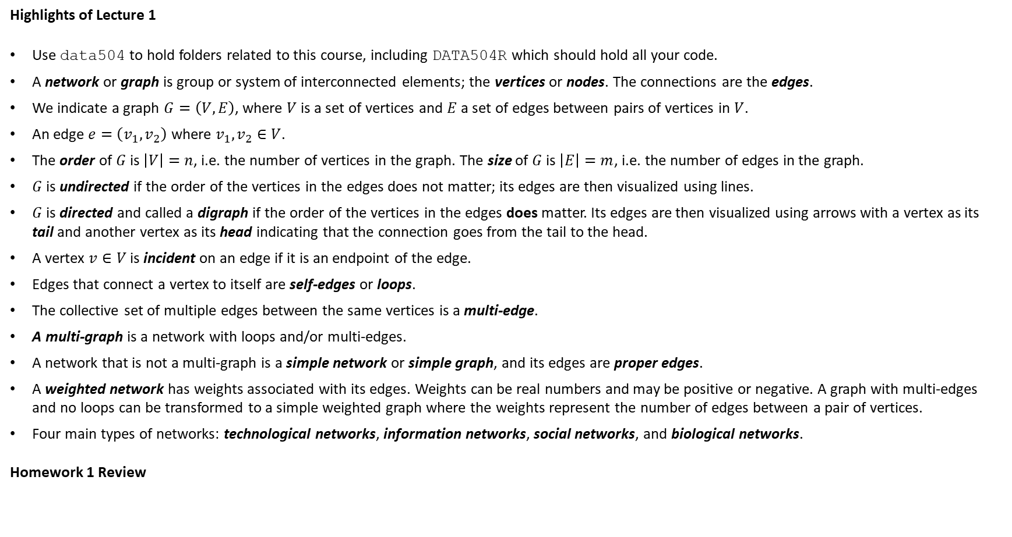
Review
Highlights of Lecture 1
Use data504 to hold folders related to this course, including DATA504R which should hold all your code.
A network or graph is group or system of interconnected elements; the vertices or nodes. The connections are the edges.
We indicate a graph $G=\left(V,E\right)$, where $V$ is a set of vertices and $E$ a set of edges between pairs of vertices in $V$.
An edge $e=\left(v_{1},v_{2}\right)$ where $v_{1},v_{2}∈V$.
The order of $G$ is $\left|V\right|=n$, i.e. the number of vertices in the graph. The size of $G$ is $\left|E\right|=m$, i.e. the number of edges in the graph.
$G$ is undirected if the order of the vertices in the edges does not matter; its edges are then visualized using lines.
$G$ is directed and called a digraph if the order of the vertices in the edges does matter. Its edges are then visualized using arrows with a vertex as its tail and another vertex as its head indicating that the connection goes from the tail to the head.
A vertex $v∈V$ is incident on an edge if it is an endpoint of the edge.
Edges that connect a vertex to itself are self-edges or loops.
The collective set of multiple edges between the same vertices is a multi-edge.
A multi-graph is a network with loops and/or multi-edges.
A network that is not a multi-graph is a simple network or simple graph, and its edges are proper edges.
A weighted network has weights associated with its edges. Weights can be real numbers and may be positive or negative. A graph with multi-edges and no loops can be transformed to a simple weighted graph where the weights represent the number of edges between a pair of vertices.
Four main types of networks: technological networks, information networks, social networks, and biological networks.
Homework 1 Review

Slide 4
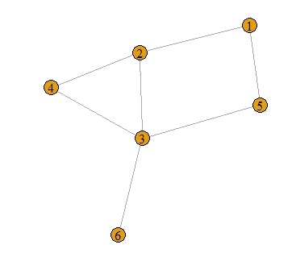
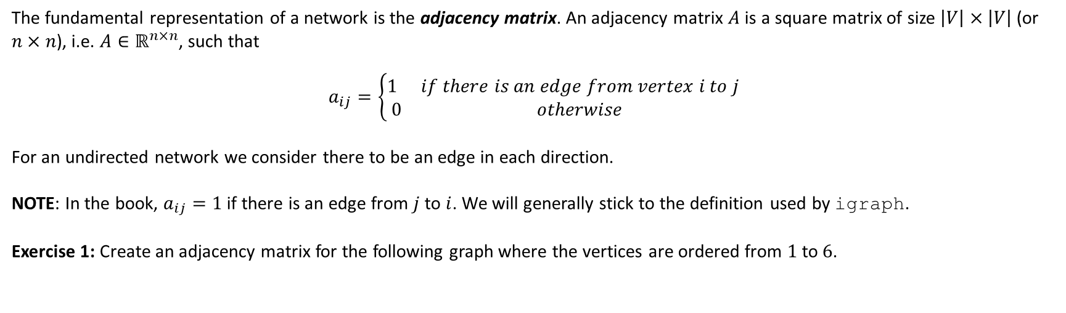
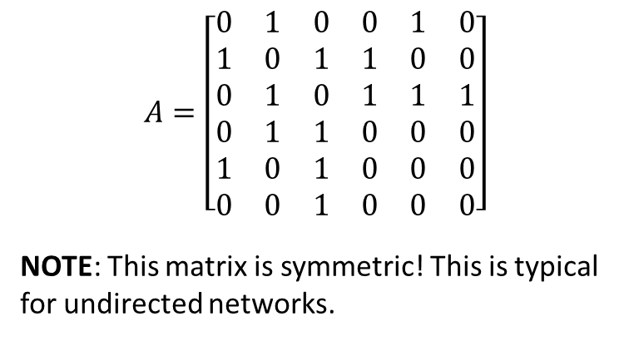
The Adjacency Matrix
The fundamental representation of a network is the adjacency matrix. An adjacency matrix $A$ is a square matrix of size $\left|V\right|×\left|V\right|$ (or $n×n$), i.e. $A∈ℝ^{n×n}$, such that
$$a_{ij}=\left\{\begin{matrix}1 & if there is an edge from vertex i to j \\ 0 & otherwise\end{matrix}\right.$$
For an undirected network we consider there to be an edge in each direction.
NOTE: In the book, $a_{ij}=1$ if there is an edge from $j$ to $i$. We will generally stick to the definition used by igraph.
Exercise 1: Create an adjacency matrix for the following graph where the vertices are ordered from $1$ to $6$.
$$A=\left[\begin{matrix}0 & 1 & 0 & 0 & 1 & 0 \\ 1 & 0 & 1 & 1 & 0 & 0 \\ 0 & 1 & 0 & 1 & 1 & 1 \\ 0 & 1 & 1 & 0 & 0 & 0 \\ 1 & 0 & 1 & 0 & 0 & 0 \\ 0 & 0 & 1 & 0 & 0 & 0\end{matrix}\right]$$
NOTE: This matrix is symmetric! This is typical for undirected networks.

Slide 5
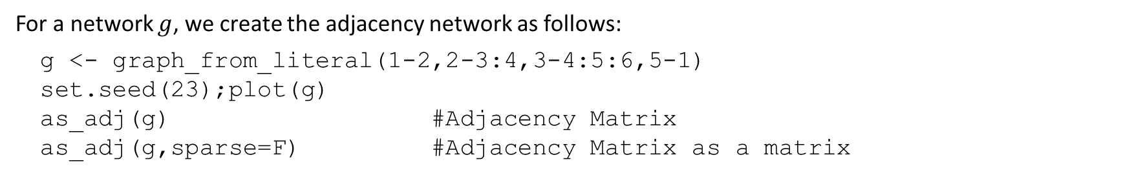
The Adjacency Matrix - 2 in R
For a network $g$, we create the adjacency network as follows:
g <- graph_from_literal(1-2,2-3:4,3-4:5:6,5-1)
set.seed(23);plot(g)
as_adj(g) #Adjacency Matrix
as_adj(g,sparse=F) #Adjacency Matrix as a matrix
1 2 3 4 5 6
1 . 1 . . 1 .
2 1 . 1 1 . .
3 . 1 . 1 1 1
4 . 1 1 . . .
5 1 . 1 . . .
6 . . 1 . . .
1 2 3 4 5 6
1 0 1 0 0 1 0
2 1 0 1 1 0 0
3 0 1 0 1 1 1
4 0 1 1 0 0 0
5 1 0 1 0 0 0
6 0 0 1 0 0 0

Slide 6
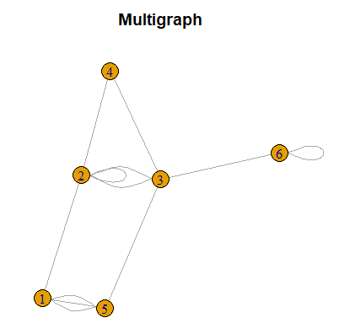
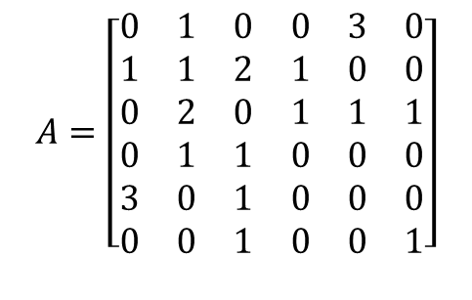

The Adjacency Matrix - 3
We can create an adjacency matrix for a multigraph in the same way.
NOTE: In the book, self loops are doubled.
Exercise 2: Create an adjacency matrix for the following graph where the vertices are ordered from $1$ to $6$.
$$A=\left[\begin{matrix}0 & 1 & 0 & 0 & 3 & 0 \\ 1 & 1 & 2 & 1 & 0 & 0 \\ 0 & 2 & 0 & 1 & 1 & 1 \\ 0 & 1 & 1 & 0 & 0 & 0 \\ 3 & 0 & 1 & 0 & 0 & 0 \\ 0 & 0 & 1 & 0 & 0 & 1\end{matrix}\right]$$
R-code:
gm <- graph_from_literal(1-2,2-2:3:3:4,3-4:5:6,5-1:1:1,6-6,simplify=F)
set.seed(23);plot(gm, main="Multigraph")
as_adj(gm)
1 2 3 4 5 6
1 . 1 . . 3 .
2 1 1 2 1 . .
3 . 2 . 1 1 1
4 . 1 1 . . .
5 3 . 1 . . .
6 . . 1 . . 1

Slide 7
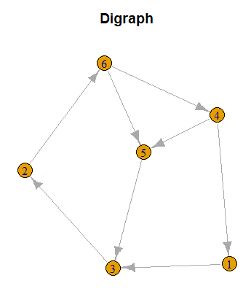
The Adjacency Matrix - 4
Exercise 3: Create an adjacency matrix for the following digraph. Use the order 1,3,2,6,4,5 for the vertices.
R-code:
gd <- graph_from_literal(1-+3-+2-+6-+4-+1,4-+5-+3,5+-6)
set.seed(23);plot(gd,main="Digraph")
as_adj(gd)
1 3 2 6 4 5
1 . 1 . . . .
3 . . 1 . . .
2 . . . 1 . .
6 . . . . 1 1
4 1 . . . . 1
5 . 1 . . . .
NOTE: Using graph_from_literal turns every numbered vertex into a name, internally numbered in order of occurrence. Therefore the numbers in this adjacency matrix are not consecutive! This can be resolved by making sure the vertices are named in the order you want them, or by using the function make_graph instead which treats integers as the indices of the vertices rather than vertex names.

Slide 8
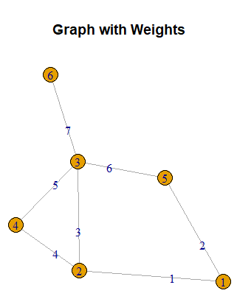
The Adjacency Matrix - 5
An adjacency matrix can also represent weights. In that case, instead of an entry containing a 1 when an edge exists, it would contain the weight of the edge.
Exercise 4: For the graph in exercise 1, let the weights be equal to the internal numbering of the edges. Then create its weighted adjacency matrix, with the vertices ordered consecutively.
R-code:
E(g)$weight=E(g) #Let weight be the internal value of the edges
E(g)$label=E(g) #Let label also be the internal value of the edges
set.seed(23);plot(g, main="Graph with Weights")
as_adj(g,attr="weight")
1 2 3 4 5 6
1 . 1 . . 2 .
2 1 . 3 4 . .
3 . 3 . 5 6 7
4 . 4 5 . . .
5 2 . 6 . . .
6 . . 7 . . .

Slide 9
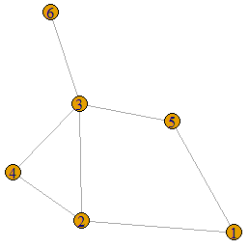
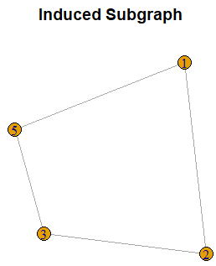
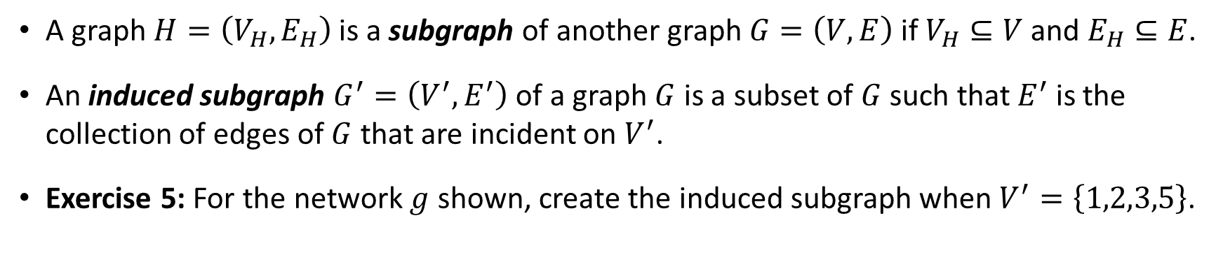
Subgraphs
A graph $H=\left(V_{H},E_{H}\right)$ is a subgraph of another graph $G=\left(V,E\right)$if $V_{H}⊆V$ and $E_{H}⊆E$.
An induced subgraph $G^{′}=\left(V^{′},E^{′}\right)$ of a graph $G$ is a subset of $G$ such that $E^{′}$ is the collection of edges of $G$ that are incident on $V^{′}$.
Exercise 5: For the network $g$ shown, create the induced subgraph when $V^{′}=\left\{1,2,3,5\right\}$.
R-code:(h=induced_subgraph(g,c(1:3,5)))
par(mfrow=c(1,2))
set.seed(23);plot(g,main="Original");plot(h, main="Induced Subgraph")

Slide 10
Decorating Graphs
Networks often have additional information; some of it related to the vertices, some of it related to the edges, and some of it related to the graph itself. We call this additional information the attributes; we have vertex attributes, edge attributes, and graph attributes.
Equipping a graph with attributes is referred to as decorating the graph.
We have already seen some examples of this; vertex names, vertex labels, edge weights, and edge labels. There can be many more.
In igraph, some attributes have a special effect on the visualization of the networks, such as the labels. We will encounter many other special attributes. In addition we can have as many user-defined attributes as we want.
g$name="Test Graph" #Graph attribute
#Vertex attributes
V(g)$label=c("Joe","Jill","Pete","Jack","Mary","Rick")
V(g)$gender=c("M","F",rep("M",2),"F","M")
#Edge attribute
E(g)$group=c("family","friends",rep("work",3),rep("family",2))
Let’s save two of our graphs. Recall that we save R objects as follows:
save(g,file="../data/g.RData")
save(gd,file="../data/gd.RData")

Slide 11
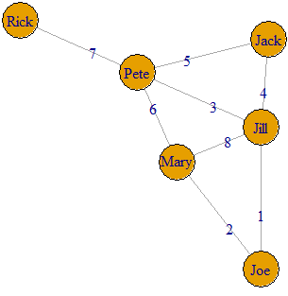
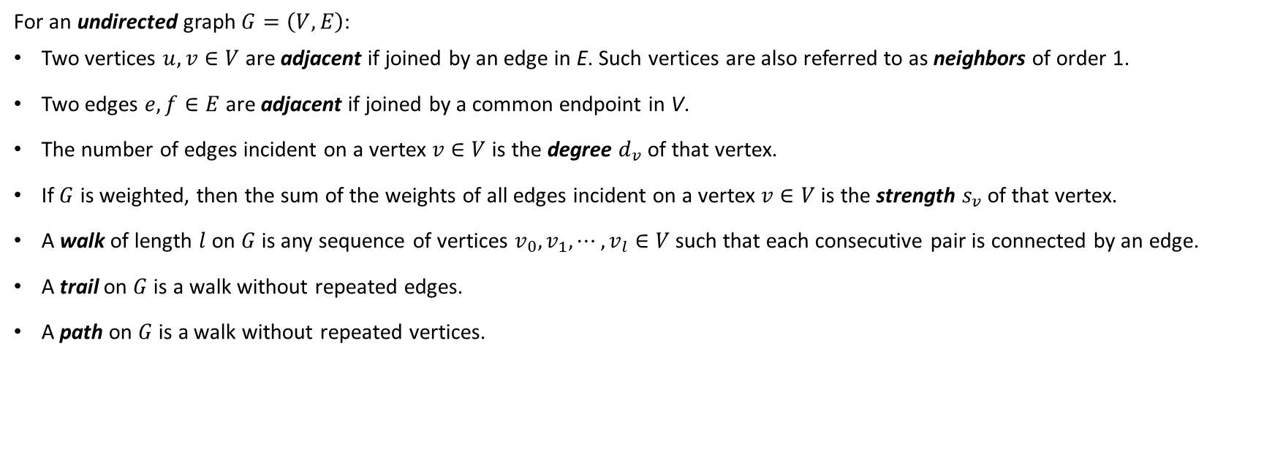
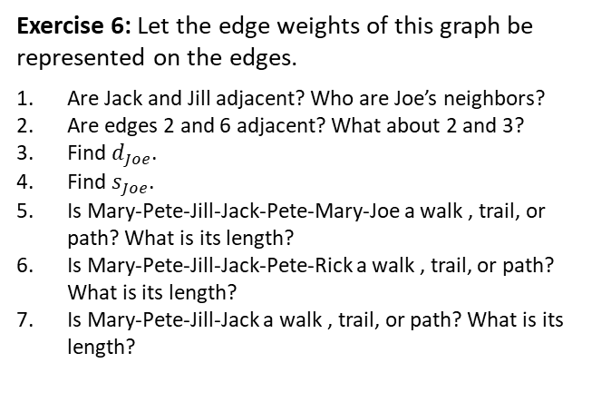
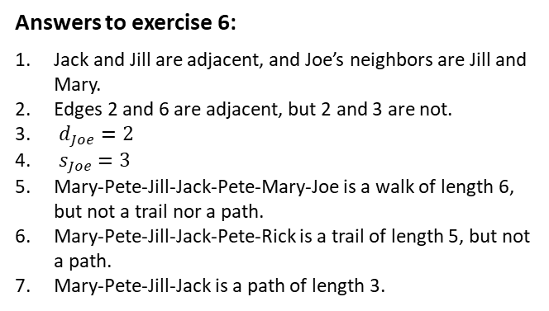
Basic Graph Concepts
For an undirected graph $G=\left(V,E\right)$:
Two vertices $u,v∈V$ are adjacent if joined by an edge in E. Such vertices are also referred to as neighbors of order 1.
Two edges $e,f∈E$ are adjacent if joined by a common endpoint in V.
The number of edges incident on a vertex $v∈V$ is the degree $d_{v}$ of that vertex.
If $G$ is weighted, then the sum of the weights of all edges incident on a vertex $v∈V$ is the strength $s_{v}$ of that vertex.
A walk of length $l$ on $G$ is any sequence of vertices $v_{0}, v_{1},⋯,v_{l}∈V$ such that each consecutive pair is connected by an edge.
A trail on $G$ is a walk without repeated edges.
A path on $G$ is a walk without repeated vertices.
Exercise 6: Let the edge weights of this graph be represented on the edges.
Are Jack and Jill adjacent? Who are Joe’s neighbors?
Are edges 2 and 6 adjacent? What about 2 and 3?
Find $d_{Joe}$.
Find $s_{Joe}$.
Is Mary-Pete-Jill-Jack-Pete-Mary-Joe a walk , trail, or path? What is its length?
Is Mary-Pete-Jill-Jack-Pete-Rick a walk , trail, or path? What is its length?
Is Mary-Pete-Jill-Jack a walk , trail, or path? What is its length?
Answers to exercise 6:
Jack and Jill are adjacent, and Joe’s neighbors are Jill and Mary.
Edges 2 and 6 are adjacent, but 2 and 3 are not.
$d_{Joe}=2$
$s_{Joe}=3$
Mary-Pete-Jill-Jack-Pete-Mary-Joe is a walk of length 6, but not a trail nor a path.
Mary-Pete-Jill-Jack-Pete-Rick is a trail of length 5, but not a path.
Mary-Pete-Jill-Jack is a path of length 3.

Slide 12
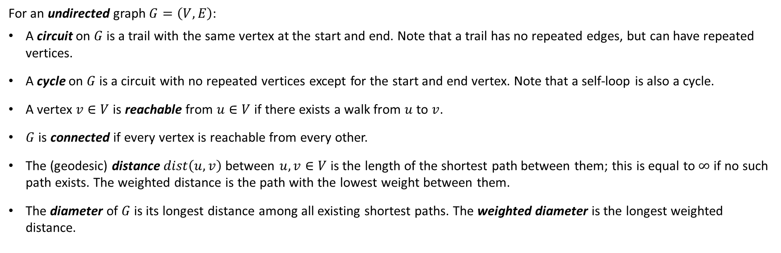
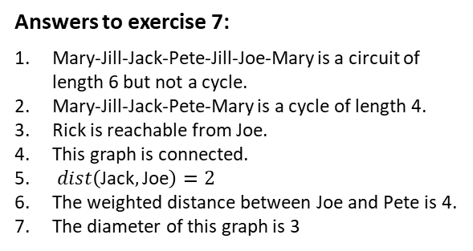
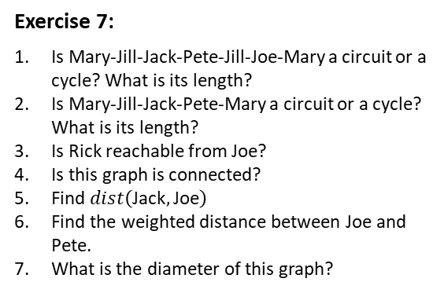
Basic Graph Concepts - 2
For an undirected graph $G=\left(V,E\right)$:
A circuit on $G$ is a trail with the same vertex at the start and end. Note that a trail has no repeated edges, but can have repeated vertices.
A cycle on $G$ is a circuit with no repeated vertices except for the start and end vertex. Note that a self-loop is also a cycle.
A vertex $v∈V$ is reachable from $u∈V$ if there exists a walk from $u$ to $v$.
$G$ is connected if every vertex is reachable from every other.
The (geodesic) distance $dist\left(u,v\right)$ between $u,v∈V$ is the length of the shortest path between them; this is equal to $∞$ if no such path exists. The weighted distance is the path with the lowest weight between them.
The diameter of $G$ is its longest distance among all existing shortest paths. The weighted diameter is the longest weighted distance.
Exercise 7:
Is Mary-Jill-Jack-Pete-Jill-Joe-Mary a circuit or a cycle? What is its length?
Is Mary-Jill-Jack-Pete-Mary a circuit or a cycle? What is its length?
Is Rick reachable from Joe?
Is this graph is connected?
Find $dist\left(\text{Jack},\text{Joe}\right)$
Find the weighted distance between Joe and Pete.
What is the diameter of this graph?
Answers to exercise 7:
Mary-Jill-Jack-Pete-Jill-Joe-Mary is a circuit of length 6 but not a cycle.
Mary-Jill-Jack-Pete-Mary is a cycle of length 4.
Rick is reachable from Joe.
This graph is connected.
$dist\left(\text{Jack},\text{Joe}\right)=2$
The weighted distance between Joe and Pete is 4.
The diameter of this graph is 3

Slide 13
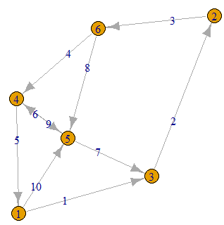
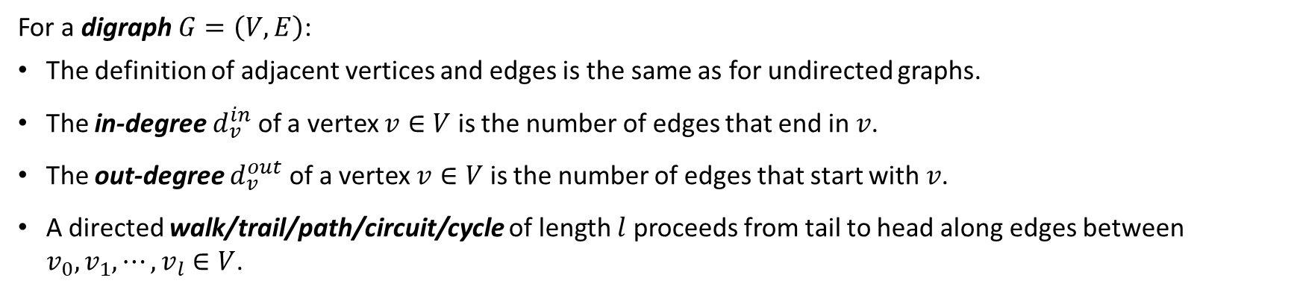
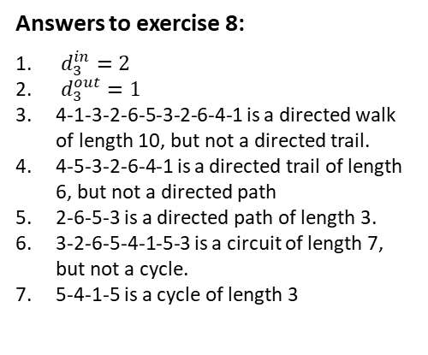
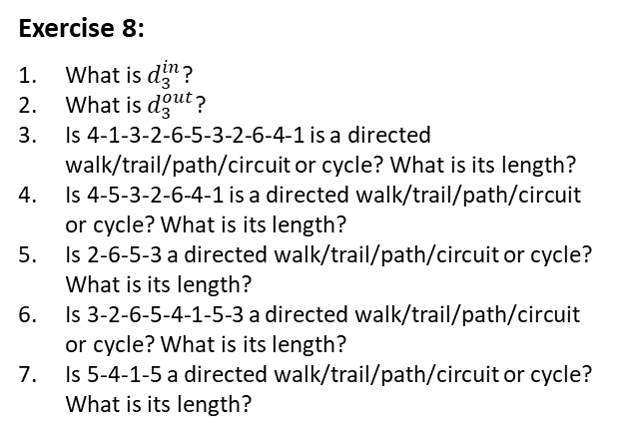
Basic Graph Concepts - 3
For a digraph $G=\left(V,E\right)$:
The definition of adjacent vertices and edges is the same as for undirected graphs.
The in-degree $d_{v}^{in}$ of a vertex $v∈V$ is the number of edges that end in $v$.
The out-degree $d_{v}^{out}$ of a vertex $v∈V$ is the number of edges that start with $v$.
A directed walk/trail/path/circuit/cycle of length $l$ proceeds from tail to head along edges between $v_{0}, v_{1},⋯,v_{l}∈V$.
Exercise 8:
What is $d_{3}^{in}$?
What is $d_{3}^{out}$?
Is 4-1-3-2-6-5-3-2-6-4-1 is a directed walk/trail/path/circuit or cycle? What is its length?
Is 4-5-3-2-6-4-1 is a directed walk/trail/path/circuit or cycle? What is its length?
Is 2-6-5-3 a directed walk/trail/path/circuit or cycle? What is its length?
Is 3-2-6-5-4-1-5-3 a directed walk/trail/path/circuit or cycle? What is its length?
Is 5-4-1-5 a directed walk/trail/path/circuit or cycle? What is its length?
Answers to exercise 8:
$d_{3}^{in}=2$
$d_{3}^{out}=1$
4-1-3-2-6-5-3-2-6-4-1 is a directed walk of length 10, but not a directed trail.
4-5-3-2-6-4-1 is a directed trail of length 6, but not a directed path
2-6-5-3 is a directed path of length 3.
3-2-6-5-4-1-5-3 is a circuit of length 7, but not a cycle.
5-4-1-5 is a cycle of length 3

Slide 14
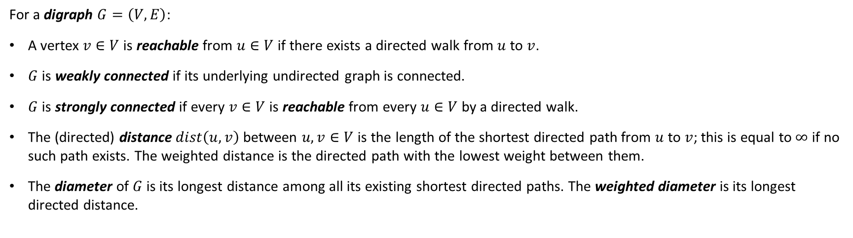
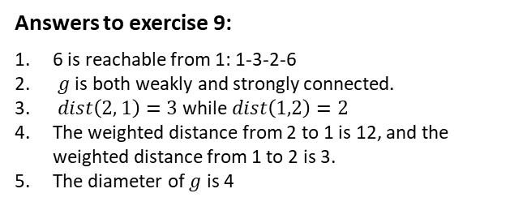
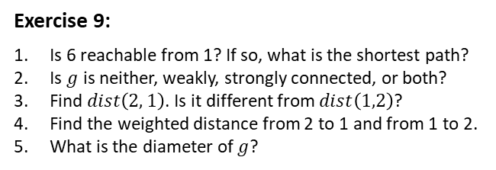
Basic Graph Concepts - 4
For a digraph $G=\left(V,E\right)$:
A vertex $v∈V$ is reachable from $u∈V$ if there exists a directed walk from $u$ to $v$.
$G$ is weakly connected if its underlying undirected graph is connected.
$G$ is strongly connected if every $v∈V$ is reachable from every $u∈V$ by a directed walk.
The (directed) distance $dist\left(u,v\right)$ between $u,v∈V$ is the length of the shortest directed path from $u$ to $v$; this is equal to $∞$ if no such path exists. The weighted distance is the directed path with the lowest weight between them.
The diameter of $G$ is its longest distance among all its existing shortest directed paths. The weighted diameter is its longest directed distance.
Exercise 9:
Is 6 reachable from 1? If so, what is the shortest path?
Is $g$ is neither, weakly, strongly connected, or both?
Find $dist\left(2, 1\right)$. Is it different from $dist\left(1,2\right)$?
Find the weighted distance from 2 to 1 and from 1 to 2.
What is the diameter of $g$?
Answers to exercise 9:
6 is reachable from 1: 1-3-2-6
$g$ is both weakly and strongly connected.
$dist\left(2, 1\right)=3$ while $dist\left(1,2\right)=2$
The weighted distance from 2 to 1 is 12, and the weighted distance from 1 to 2 is 3.
The diameter of $g$ is 4

Slide 15
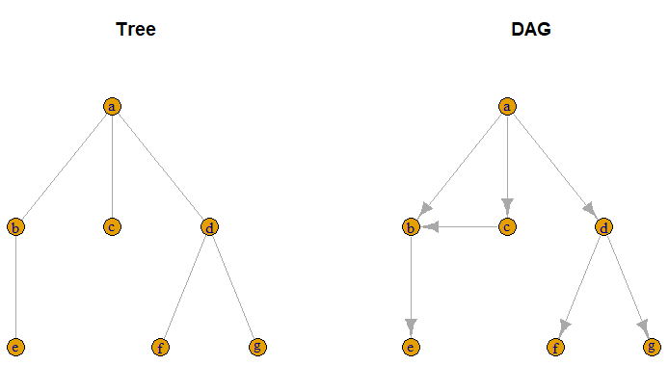
Acyclic Networks
An acyclic network is a network without any cycles.
A connected undirected acyclic network is called a tree.
A directed acyclic network, or DAG, is a directed network without directed cycles.
NOTE: The underlying undirected network of a DAG may have cycles!
Graphically, a DAG can be depicted with all its arrows pointing downward. If we then order the vertices such that all edges point from higher ordered vertices to lower ones, its adjacency matrix is strictly lower triangular.
A network whose vertices can be ordered such that its adjacency matrix is strictly lower triangular, or strictly upper triangular, represents a DAG.
Example: A citation network is a DAG, since only papers that have already been written can be cited.
DAG
adjacency matrix
e f g b c d a
e . . . . . . .
f . . . . . . .
g . . . . . . .
b 1 . . . . . .
c . . . 1 . . .
d . 1 1 . . . .
a . . . 1 1 1 .

Slide 16
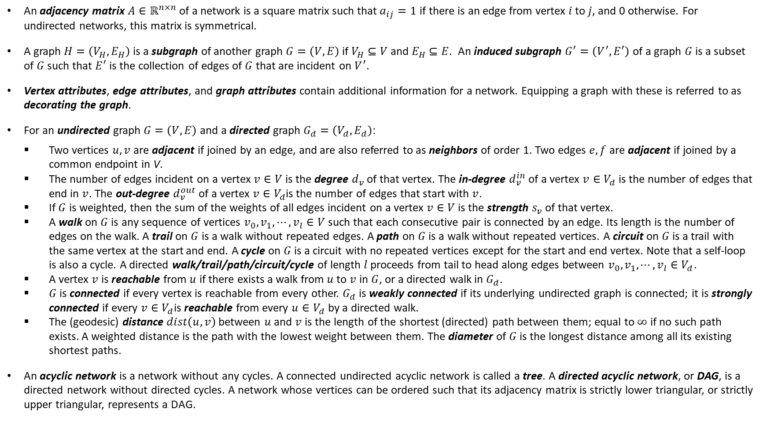
Today’s Summary
An adjacency matrix $A∈ℝ^{n×n}$ of a network is a square matrix such that $a_{ij}=1$ if there is an edge from vertex $i$ to $j$, and 0 otherwise. For undirected networks, this matrix is symmetrical.
A graph $H=\left(V_{H},E_{H}\right)$ is a subgraph of another graph $G=\left(V,E\right)$if $V_{H}⊆V$ and $E_{H}⊆E$. An induced subgraph $G^{′}=\left(V^{′},E^{′}\right)$ of a graph $G$ is a subset of $G$ such that $E^{′}$ is the collection of edges of $G$ that are incident on $V^{′}$.
Vertex attributes, edge attributes, and graph attributes contain additional information for a network. Equipping a graph with these is referred to as decorating the graph.
For an undirected graph $G=\left(V,E\right)$ and a directed graph $G_{d}=\left(V_{d},E_{d}\right)$:
Two vertices $u,v$ are adjacent if joined by an edge, and are also referred to as neighbors of order 1. Two edges $e,f$ are adjacent if joined by a common endpoint in V.
The number of edges incident on a vertex $v∈V$ is the degree $d_{v}$ of that vertex. The in-degree $d_{v}^{in}$ of a vertex $v∈V_{d}$ is the number of edges that end in $v$. The out-degree $d_{v}^{out}$ of a vertex $v∈V_{d}$is the number of edges that start with $v$.
If $G$ is weighted, then the sum of the weights of all edges incident on a vertex $v∈V$ is the strength $s_{v}$ of that vertex.
A walk on $G$ is any sequence of vertices $v_{0}, v_{1},⋯,v_{l}∈V$ such that each consecutive pair is connected by an edge. Its length is the number of edges on the walk. A trail on $G$ is a walk without repeated edges. A path on $G$ is a walk without repeated vertices. A circuit on $G$ is a trail with the same vertex at the start and end. A cycle on $G$ is a circuit with no repeated vertices except for the start and end vertex. Note that a self-loop is also a cycle. A directed walk/trail/path/circuit/cycle of length $l$ proceeds from tail to head along edges between $v_{0}, v_{1},⋯,v_{l}∈V_{d}$.
A vertex $v$ is reachable from $u$ if there exists a walk from $u$ to $v$ in $G$, or a directed walk in $G_{d}$.
$G$ is connected if every vertex is reachable from every other. $G_{d}$ is weakly connected if its underlying undirected graph is connected; it is strongly connected if every $v∈V_{d}$is reachable from every $u∈V_{d}$ by a directed walk.
The (geodesic) distance $dist\left(u,v\right)$ between $u$ and $v$ is the length of the shortest (directed) path between them; equal to $∞$ if no such path exists. A weighted distance is the path with the lowest weight between them. The diameter of $G$ is the longest distance among all its existing shortest paths.
An acyclic network is a network without any cycles. A connected undirected acyclic network is called a tree. A directed acyclic network, or DAG, is a directed network without directed cycles. A network whose vertices can be ordered such that its adjacency matrix is strictly lower triangular, or strictly upper triangular, represents a DAG.

